Slide 1

SCOUT : Smart Camera Observation & Unusual Tracking
SCOUT is an innovative home security system that leverages advanced AI algorithms to provide comprehensive real-time protection for your home and family.
Notes:
1

Slide 2
Problem Statement
Traditional home security systems often lack advanced intelligence, leading to excessive false alarms, inefficient recording, and insufficient emergency detection capabilities. Moreover, many systems fail to address critical safety concerns like fall detection for the elderly or rapid fire detection, leaving homes vulnerable. With the increasing need for personalized, proactive, and privacy-focused solutions, there is a gap in the market for a system that integrates real-time surveillance, smart detection, and emergency response while ensuring user privacy and adaptability to modern smart home environments.
Notes:
1

Slide 3
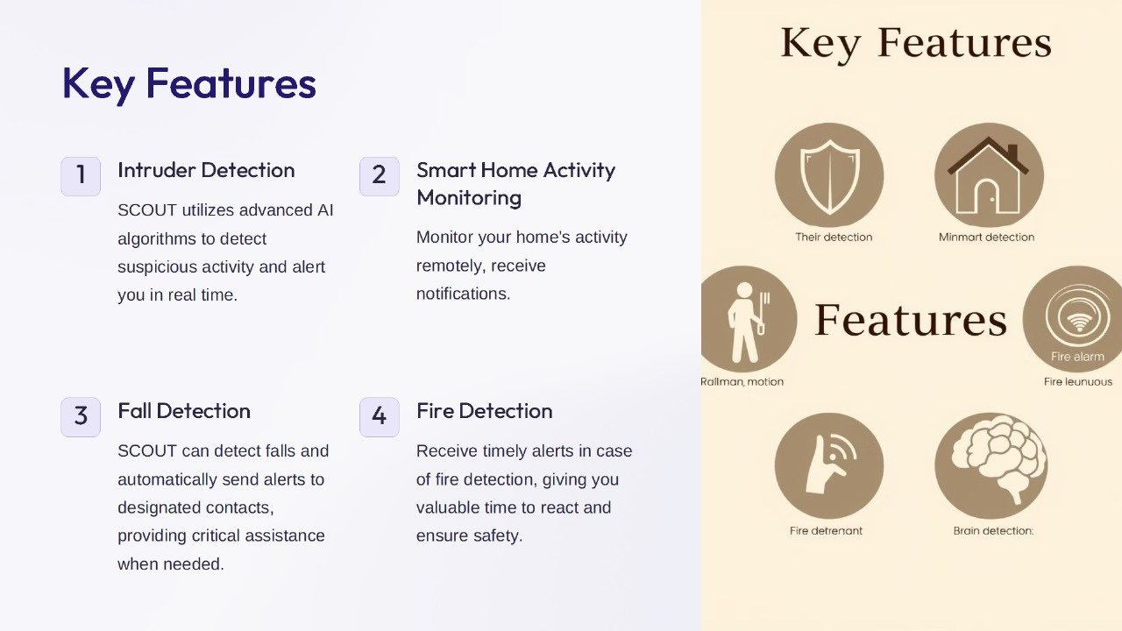
Notes:
2

Slide 4

Advanced AI Algorithms
1
Accurate Threat Detection
2
Continuous Learning
SCOUT's machine learning models adapt and improve over time, enhancing its threat detection capabilities.
SCOUT's AI-powered algorithms quickly and precisely identify potential threats, minimizing false alarms.
3
Customizable Rules
Tailor SCOUT's monitoring and alert preferences to your unique home environment and preferences.
Notes:
4

Slide 5

Professional Monitoring and Emergency Response
24/7 Monitoring
1
SCOUT's professional monitoring service ensures your home is under constant surveillance.
2
Rapid Response
In the event of an emergency, SCOUT's team will immediately dispatch the appropriate authorities.
Notes:
5

Slide 6

Secure Your Home, Safeguard Your Family
Real-Time Protection
Privacy-Focused Design
SCOUT's advanced AI-powered security system provides comprehensive, 24/7 monitoring and rapid response.
SCOUT's on-device processing and transparent practices ensure your personal data remains secure and private.
Seamless Integration
Professional Support
SCOUT seamlessly integrates with your existing smart home devices for a unified, user-friendly experience.
SCOUT's optional 24/7 monitoring and emergency response service provides an added layer of security.
Notes:
6

Slide 7
Privacy-Focused On-Device Processing
Respecting Your Space
Transparent Practices
Protecting Your Data
SCOUT processes data locally on your devices, ensuring your personal information remains secure and private.
SCOUT's discrete design and on-device processing respect your home environment and minimize intrusion.
SCOUT's policies prioritize transparency, giving you full control over your data and privacy.
Notes:
3

Slide 8
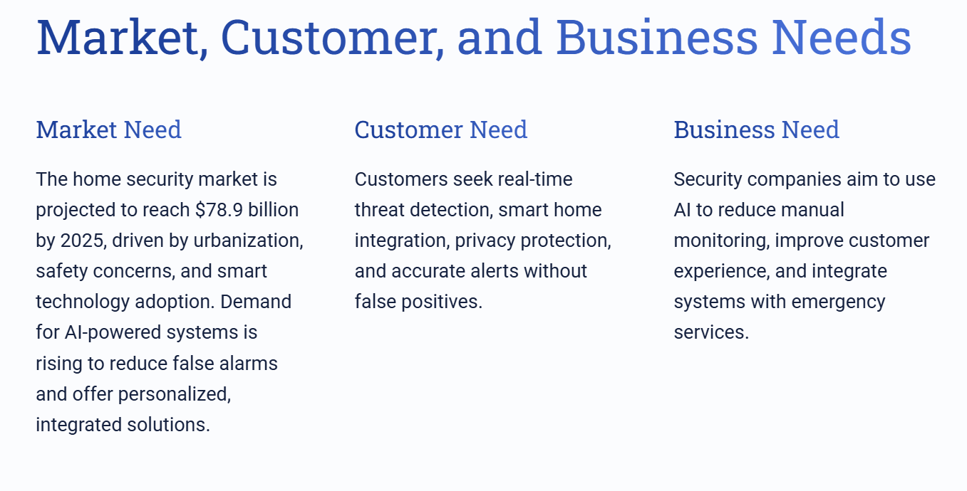

Slide 9



Customers
Urban homeowners/renters with mid-to-high incomes seeking smart home automation.
Characteristics
Tech-savvy, privacy-conscious, and prefer reliable, automated home monitoring.

Slide 10
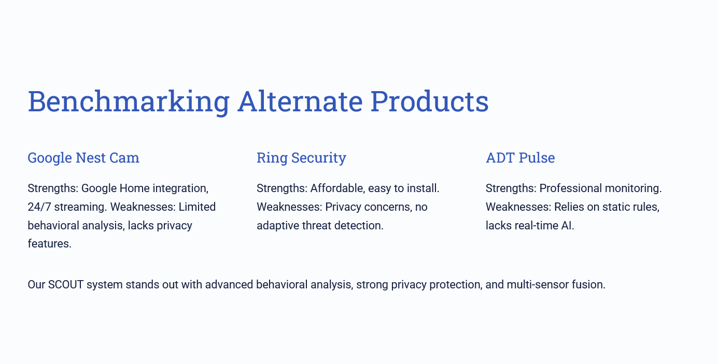

Slide 11




Slide 12
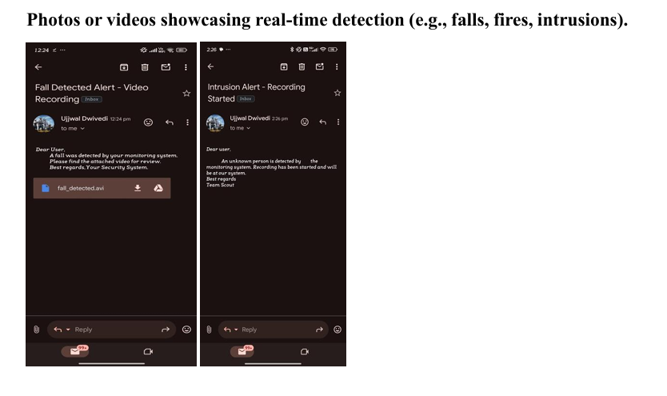
Results

Slide 13
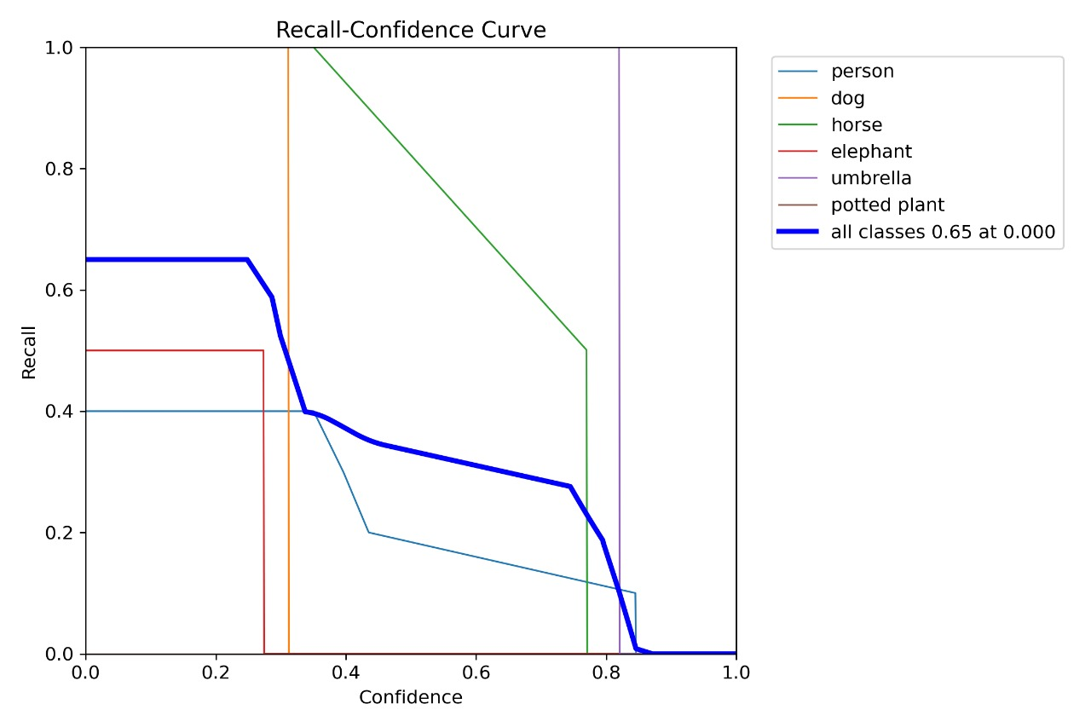
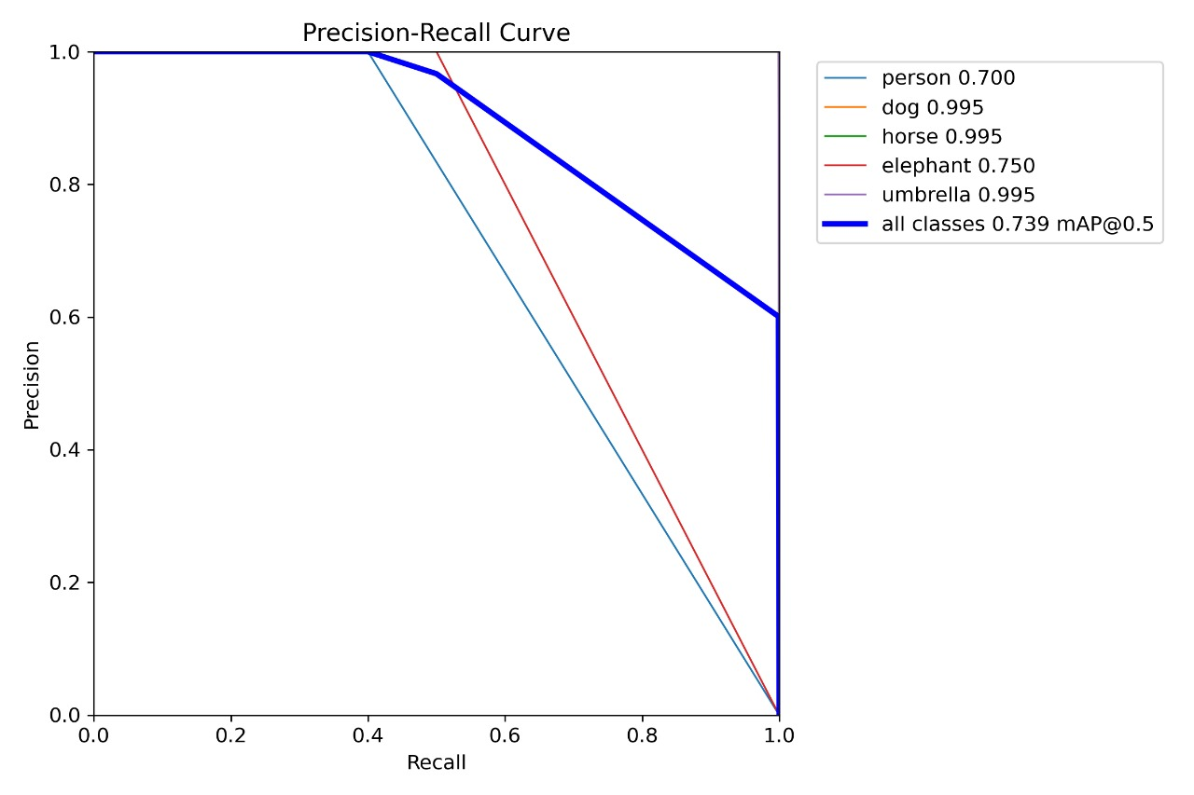
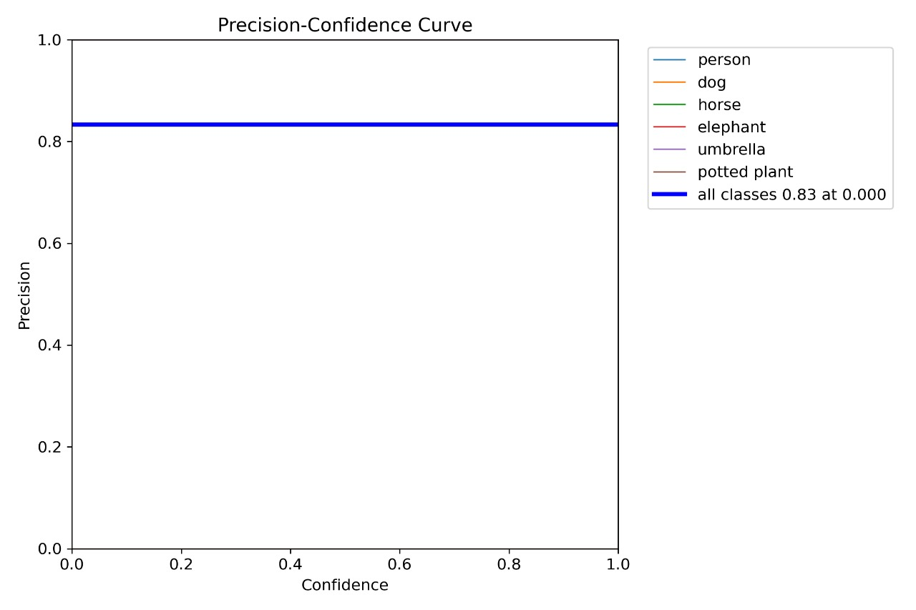
Results (Graphs)

Slide 14
References
“A Machine Learning Approach for Fall Detection and Daily Living Activity Recognition” date of publication March 21, 2019 at Int.Conf.IEEE .
“ An improved fire detection approach based on YOLO-v8 for smart cities” date of publication 28 July 2023 at Int.Conf.IEEE .
“Hawk-Eye: An AI-Powered Threat Detector for Intelligent Surveillance Cameras” date of publication 12 May 2021 at Int.Conf.IEEE .

Slide 15


Our Team
Satyam Singhal
Ujjwal Dwivedi
Rohit Verma
Laxman Singh
(Mentor)

Slide 16


